Slide 1
THE UNIVERSITY IN TIMES OF CULTURAL SHOCK
Luiz Bevilacqua
COLÓQUIO - IF-UFRJ
JUNE 2015

Slide 2
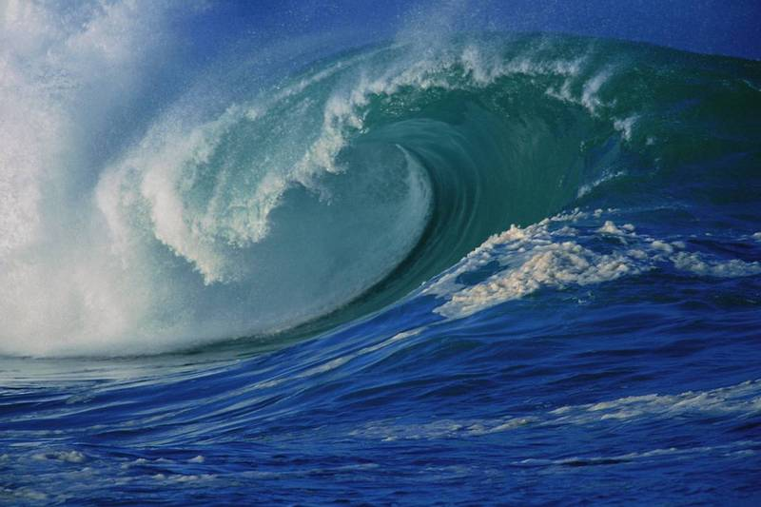
THE ERA OF CULTURAL SHOCK
More than the era of knowledge the present times may be best characterized by the speed of the scientific and technological advancement.
Past and future converge into present producing what we may translate as a shock wave. We are living in the era of cultural shock.
THIS IS A SHOCK WAVE

Slide 3
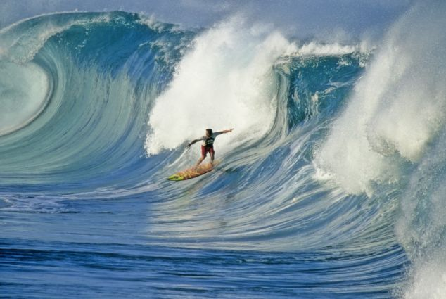
SURFING IS THE PROPER WAY TO MOVE ALONG A SHOCK WAVE
SURFING IS NOT A NEW SWIMMING STYLE REQUIRES NEW SKILLS.
A BOARD IS NECESSARY

Slide 4
THE CHALLENGES OF THE
NEW ERA
THE TRADITIONAL UNIVERSITY ORGANIZATION IS HOPELESS
THERE IS NO MUCH TIME TO THINK AND TAKE DECISIONS
IT IS NECEESARY TO UNDERTAKE RISKS
IT IS NECESSARY TO BE PREPARED TO MAKE QUICK CHANGES IN ORIENTATION
IT IS NECESSARY TO CHALLENGE TRADICIONAL RULES AND FIGHT FOR NEW AND MORE FLEXIBLE STATUTES ADEQUATED TO THE PRESENT TIMES
IT IS NECESSARY TO FIND A SUITABLE BOARD
ANYWAY IT IS NECESSARY TO BE PREPARED TO FALL DOWN AND GET TO YOUR FEET AGAIN

Slide 5
THE NEW UNIVERSITY
Learn rather than Teach
The University must be a place intended primary to learn rather than teach
The sharp boundaries separating the university community into very specific layers (profs, students, technicians, etc) should be dissolved. Extinction of the departmental structure.
It is crucial to build up a new academic community

Slide 6
THE NEW UNIVERSITY
Do not pour new wine in old bottles
Interdisciplinary research has come to stay. It is already a successful approach to tackle complex problems
Courses, particularly undergraduate courses follow the classical organization
This is a contradiction and confuses the students

Slide 7
THE NEW UNIVERSITY
First discover then publish
Advancement of knowledge rather than thickening the authors’ CV should be the focus of publication
The contribution of a scientist is not measured by volume but by the scientific value of the contents
The pressure for quantity instead of quality delay the advancement of science and technology

Slide 8
THE NEW UNIVERSITY
Interdisciplinarity is not cause but consequence
There is not such a discipline “interdisciplinarity”
Interdisciplinarity results from the convergence of two or more disciplines to advance knowledge in some field
Mathematical-computational modeling is a key topic in interdisciplinary approaches

Slide 9
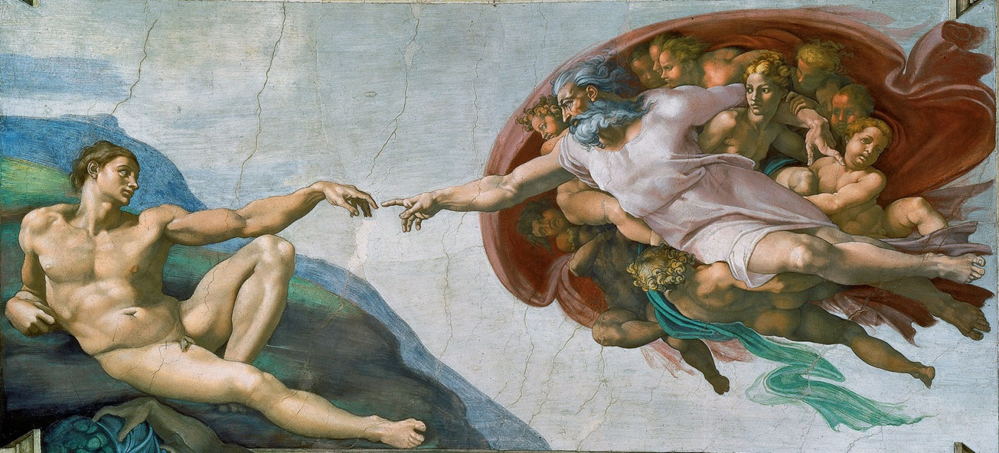
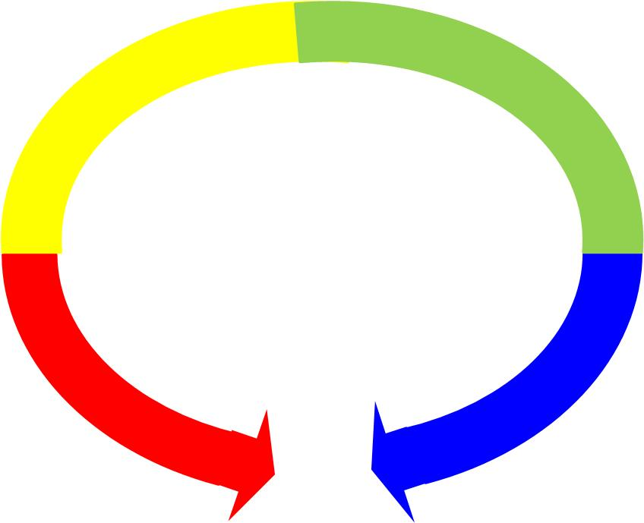
THE complete knowledge SPECTRUM
Technology
Social Sciences
Natural Sciences
Arts
Reason
Transcendence

Slide 10
BaRRIERS HAVE COLLAPSED
Physics
Mechanics
Anthrop.
Sociology
Electrical
Chemistry
Economics
Civil
Biology
Law
Materials
Pol.Sci.
Astron.
NEW SCIENCE
NEW TECHNOLOGY

Slide 11
THE UFABC PROJECT
antecedents
The Angra manifesto
The UFRJ Campus II initiative
The ABC document on higher education: “Subsidios para a Reforma do Ensino Superior”

Slide 12
THE UFABC PROJECT
Ethos and academic structure
The first committee. Seven members, professors from Federal Universities and High Education Officials- Ministry of Education (MEC) and Regional Office of Education (Sato André).
Main scope: Preparation of the General Pedagogical Project and definition of the Institutional Identity.
The second committee. Twenty five members, professors of Universities and Research Centers.
Main scope: Definition of the Scientific Guide-Lines, courses requirements, engineering carrier options, definition of the academic organization (without departments)

Slide 13
THE UFABC PROJECT
Academic structure
Abolition of the departmental organization
Three Schools:
Natural Sciences and Humanities
Mathematics and Cognition
Engineering and Social Sciences
Challenging new topics offered in courses under the supervision of the Undergraduate Studies Division
Competence prevailing over diploma
More freedom to select courses and professional options
Students are admitted to the University not to a specific course

Slide 14
President
Senate
Office of
academic
affairs
Office of
institutional research
Office of
students
Office of institutional development
and cooperation
Office of personnel management and infrastructure
Under-graduate
Graduate
Campus maintenance
and basic
facilities

Slide 15
The trajectories
BACHELLOR S&T DEGREE
UNDER-GRADUATE
GRADUATE COURSE
JOB MARKET
ANOTHER
UNIVERSITY
JOB MARKET

Slide 16
THE NEW SCIENTIFIC FRAMEWORK
Structure of Matter
Energy
Transformation Processes
  Mechanically and physically driven
  Life sciences
Communication and Information
Representation and Simulation (Mathematics)
Humanities and Social Sciences

Slide 17
OPEN KNOWLEDGE COURSES
  Neurosciences, the Brain
  The Nature of the Insight
  God and the Transcendental Knowlwdge
  Emotion and Art
  The Thermodynamics of the Amazon Rain Forest
  Sports and Politics

Slide 18
 | FIRST YEAR
1SEM | SM | SC | EN |  | HU
2SEM | SM |  | EN | MM
3SEM | SM |  | EN | MM
TOTAL 180cr
REQ 68cr
~37%
 | SECOND YEAR
1SEM | SC | TP |  | MM
2SEM |  | TP | IC
3SEM |  |  | IC |  | HU
 | THIRD YEAR
1SEM
2SEM
3SEM
EM
EN
MM
TP
IC
HU
SC

Slide 19
EDUCATION
Fostering creativity – More individual work and less classes – Think.
Building self-confidence – To dare and to reduce aversion to risk.
Learning to take decisions and to take initiaves – Less complaints and more solutions.

Slide 20
EDUCATING FOR THE FUTURE
The ufabc ethos
The main commitment of the UFABC toward society is to recover the appreciation for scientific learning, to show the beauty inherent in the mysteries of nature and hidden in a mathematical object. It was founded on the assumption that knowledge is not only a means to response to market demands but above all to the enlightenment of the human spirit.

Slide 21
EDUCATING FOR THE FUTURE
The ufabc ethos
The project of a university for the XXI century should be sustained by the freedom to explore new paths that will lead the University closer to its original and universal purpose: to discover, to invent and to think critically. The education system, more than ever, should encourage students to make their own choices, to take risks, to accept challenges and to think creatively. All this to be able to contribute effectively for the social development of our people.

Slide 22
Harvard General Education (May 2007)
A Harvard education is a liberal education—that is, an education conducted in a spirit of free inquiry undertaken without concern for topical relevance or vocational utility. This kind of learning is not only one of the enrichments of existence; it is one of the achievements of civilization.

Slide 23
Harvard General Education (May 2007)
Subject Area Descriptions
  1. Aesthetic and Interpretive Understanding
  2. Culture and Belief
  3. Empirical Reasoning
  4. Ethical Reasoning
  5. Science of Living Systems
  6. Science of the Physical Universe
  7. Societies of the World
  8. The United States in the World

Slide 24
Harvard General Education (May 2007)
We have therefore made an effort not to map these eight subject areas onto departments. We expect that some general education courses will involve collaborative teaching by faculty from different departments or even different divisions and Schools; other courses may be taught from a single disciplinary perspective.

Slide 25
The first two years
Obstacles
1. The skeptical attitude towards the ABC project
2. The fire from the left wing. Local journals and periodicals. The UFABC should response to the immediate demands of the region. The University President and Directors should come from the local community.
3. The fire from the right wing. The most prestigious newspapers of São Paulo. The UFABC is nothing but a political factoid intended to upgrade President Lula´s administration. It was called “UNILULA”.

Slide 26
The first two years
Obstacles
Teachers in the region´s high school system disqualified the UFABC´s pedagogical project
The first miscalculation. Excessive number of students admitted to the undergraduate courses
The First UFABC’s President dismissed less than one year´s service

Slide 27
The first two years
Highlights
Graduate courses started simultaneously with undergraduate courses
Rigorous admission process to join the UFABC’s faculty
Students had to achieve at least an average B grade point after two years to continue enrolled in the University
Undergraduate students stimulated to join research projects
A successful experience with the course (required):
“Experimental Methods in Natural Sciences”
The UABC remained invisible from the Educational Authorities and Professional Associations

Slide 28
Proposta para carreira Docente
Rever a lei da avaliação de desempenho ne permanência no serviço público.
a) Primeira avalição após 3 anos b) Segunda avaliação após 8 anos (3+5) c) Terceira avaliação após 15 anos (3+5+7)
Após 15 anos poderá permanecer com “tenure”.
2. Critérios de avaliação;
a) Contribuição efetiva para o avanço do conhecimento. Relato de no máximo 10 páginas com as publicações mais importantes (máximo 10)
b) Contribuição para a formação dos jovens universitários: cursos, palestras, livros textos
c)Projetos de pesquisa, cooperação com o setor industrial, contribuição para o progresso social.
d) Prêmios e participações em Instituições científicas
e) Participação em comitês de CAPES, CNPq, FAP’s etc
3) Carta de 3 professores de outras instituições que devem responder às seguintes perguntas:
a) O candidato seria promovido para ..... na sua Instituição?
B) Caso positivo indique 3 razões que suportem a promoção
4) Instituição de um comitê de 3 a 5 membros, sendo respectivamente 2 ou 3 externos.

Slide 29
EVALUATION AFTER
10 YEARS

Slide 31
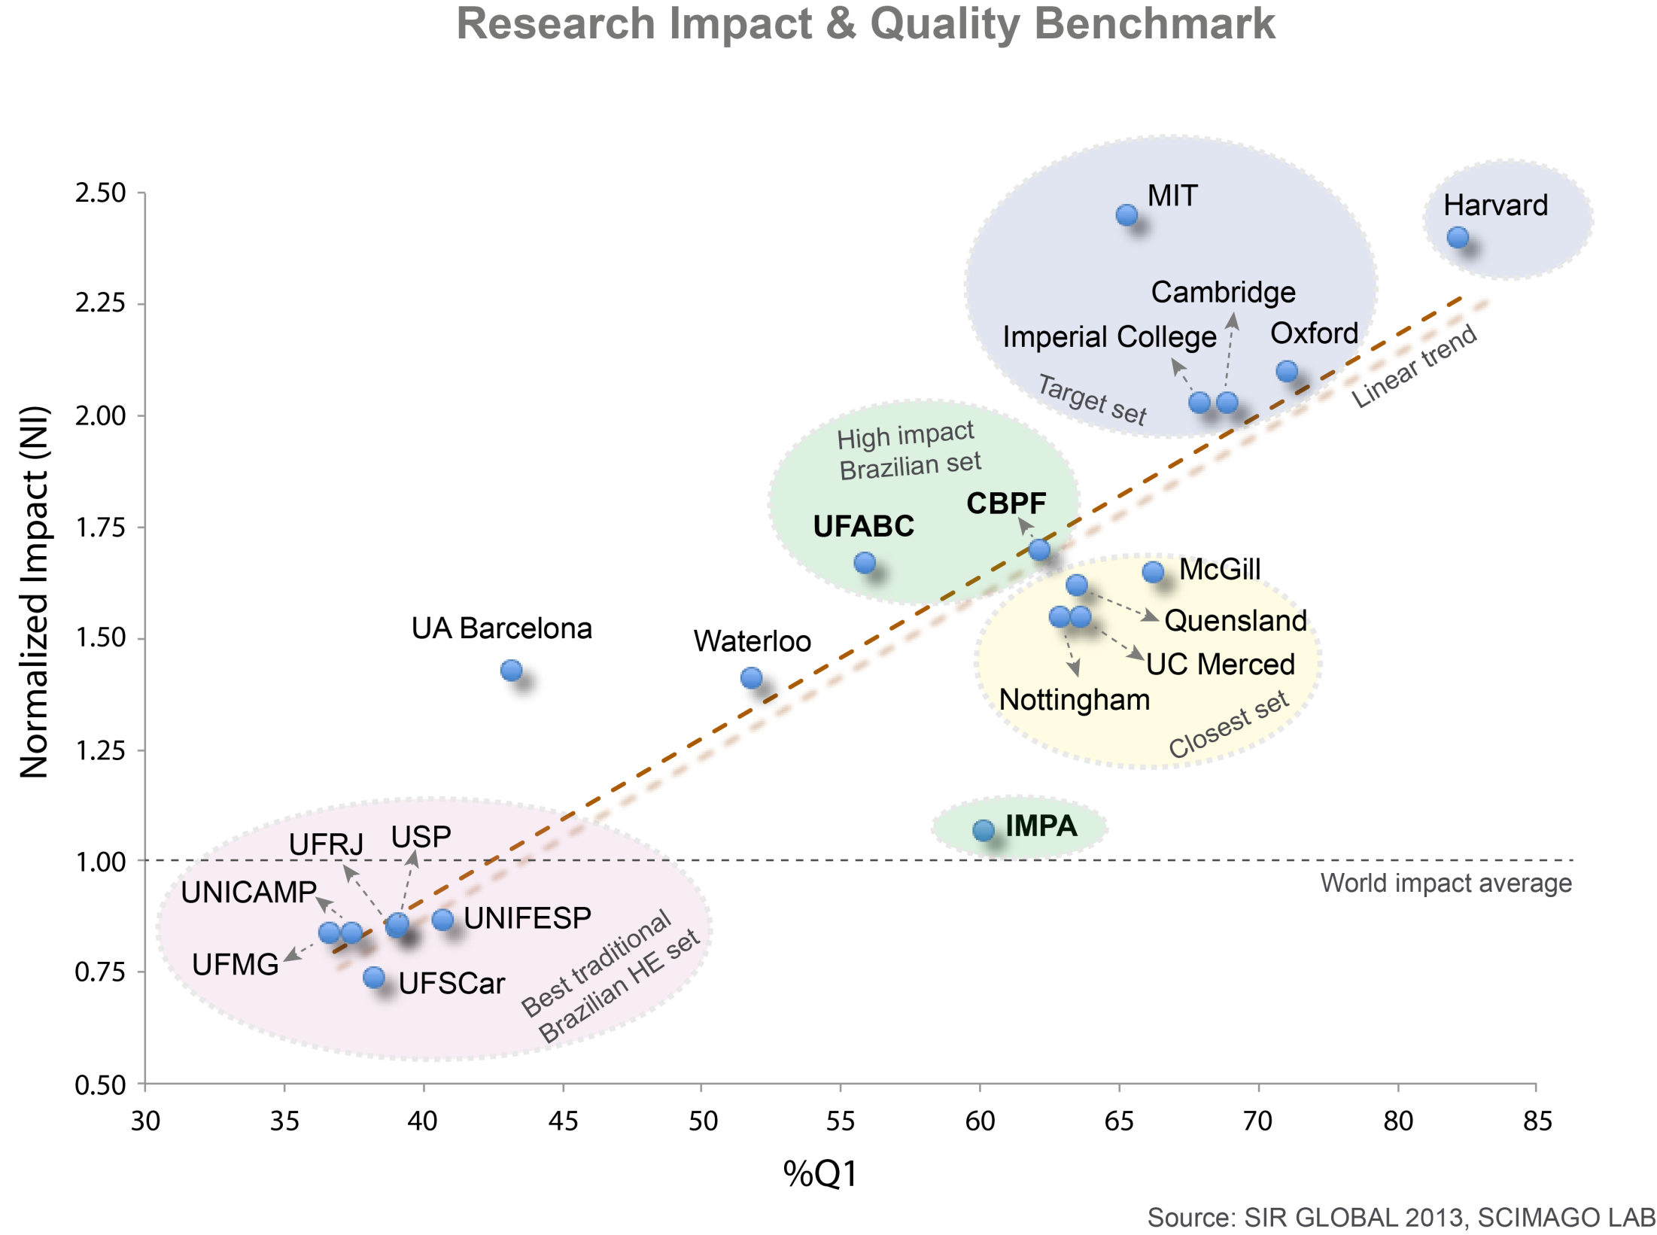

Slide 32
UNIVERSIDADES PÚBLICAS COM NOTA MÁXIMA DO MEC 2012
Último ano avaliado no Enade | Instituição | Sigla | IGC contínuo | IGC Faixa
2011 | Instituto Tecnológico de Aeronáutica | ITA | 4,60 | 5
2011 | Universidade Federal do Rio Grande do Sul | UFRGS | 4,28 | 5
2011 | Fundação Universidade Federal do ABC | UFABC | 4,26 | 5
2011 | Universidade Federal de Lavras | UFLA | 4,25 | 5
2011 | Universidade Estadual de Campinas | UNICAMP | 4,22 | 5
2011 | Instituto Militar de Engenharia | IME | 4,19 | 5
Último ano avaliado no Enade | Instituição | Sigla | IGC contínuo | IGC Faixa
2011 | Universidade Federal de Minas Gerais | UFMG | 4,14 | 5
2011 | Universidade Federal de Viçosa | UFV | 4,08 | 5
2011 | Universidade Federal do Triângulo Mineiro | UFTM | 4,05 | 5
2011 | Universidade Federal de São Carlos | UFSCAR | 4,02 | 5
2011 | Universidade Federal de Santa Catarina | UFSC | 3,98 | 5

Slide 33
CLASSIFICAÇÃO IGC-2013
Indice Geral de Cursos
GERAL: IGC: 5 (4200 pontos) Ranking 2⁰
Conceito Preliminar de Curso:
Primeiro lugar: Química (Bacharelado e Licenciatura), Matemática (Bacharelado e Licenciatura), Engenharia Ambiental e Urbana, Engenharia de Materiais

Slide 34
FOLHA DE SÃO PAULO
PRIMEIRO LUGAR NO QUESITO
INTERNACIONALIZAÇÃO

Slide 35
A student´s letter. Recipeint of the ieee prize 2014
A estrutura do BC&T e a UFABC mudaram as minhas bases educacionais,ampliaram as minhas perspectivas de vida e visão de mundo.
.............
Gostaria de dedicar este prêmio (anexo) aos senhores professores e compartilhar essas experiência dos últimos anos mostrando o quando eu considero o BC&T o grande diferencial e divisor de águas na minha formação não apenas do ponto de vista cientifico e profissional, mas também pessoal, além das diversas portas que este curso pioneiro e ousado abriu na minha vida.
............
Grato, Thiago Alencar.

Slide 36
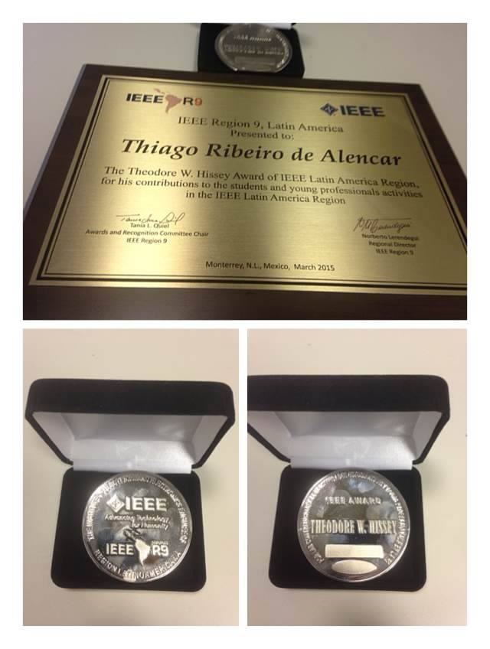
IEEE PRIZE 2014

Slide 37
World Education Forum 2015 - May 2015, Incheon, Republic of Korea
Bacharelados interdisciplinares colocam universidades federais em destaque
Durante painel sobre educação superior no Fórum Mundial de Educação, realizado em Incheon, Coreia do Sul, as universidades federais brasileiras do ABC (UFABC) e do Sul da Bahia (UFSB) ganharam destaque. A partir do modelo bem-sucedido nas duas instituições, o ministro da Educação, Renato Janine Ribeiro, explicou que o Brasil acredita na importância dos bacharelados interdisciplinares.
Esse modelo é visto como uma solução futura para a educação superior, na opinião do ministro. “Algumas áreas, como saúde e engenharia, precisam ser bem rígidas. Mas há cursos em que podemos investir nos bacharelados interdisciplinares”, explicou Janine Ribeiro.

Slide 38
The GUARDIAN (MAY 2015)
The Federal University of ABC (UFABC)
UFABC is proving the shining example of what public higher education in Brazil can become
THEGUARDIAN.COM
The Federal University of ABC (UFABC)
President Lula may have drawn much of his power base from the unions he represented in local industry, but in the creation of the ABC region’s Federal University he has paid back that loyalty. Shaking off the image of closed-off laboratories, conservative approaches and reluctance to change, UFABC is proving the shining example of what public higher education in Brazil can become

Slide 39
BERNARD SHAW
“Reasonable people adapt themselves to the world. Unreasonable people attempt to adapt the world to themselves. All progress, therefore, depends on unreasonable people.”

Slide 40
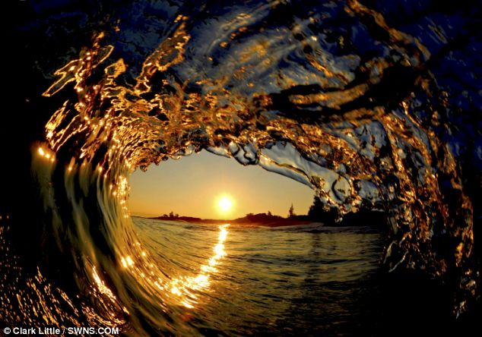
THANKS FOR YOUR ATTENTION
Let us surf

